Slide 1
Energy Policy Roundtable in the PJM Footprint
Future of Nuclear Power in the PJM
September 28, 2016

Slide 2
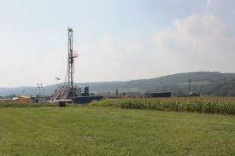
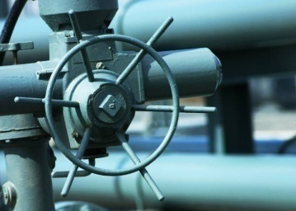
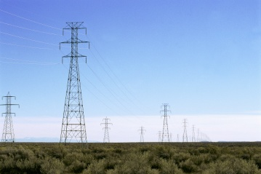
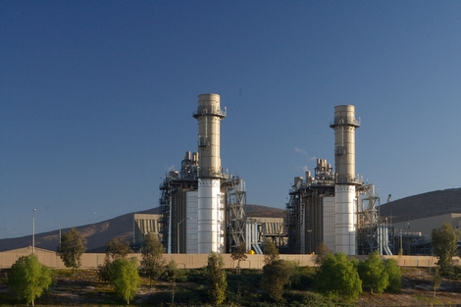
Calpine Generating Power
Strategically positioned within U.S. power industry value chain
Fuel Supply
Retail
Transportation
Transmission
& Distribution
Calpine (NYSE: CPN)
2,200 employees
27,000 MW generation capacity
84 power plants¹
Power Generation
¹ Includes one plant under construction.
1
Notes:
Review slide (build out talking points)
This is the way in which power gets to our customers
Begins with the fuel supply it is transported through gas lines to our power plants, it is then transmitted across lines to our customers.

Slide 3
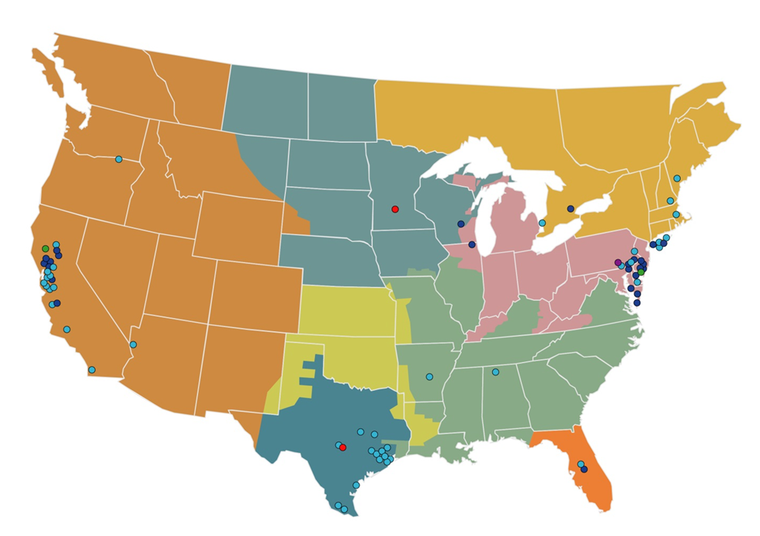
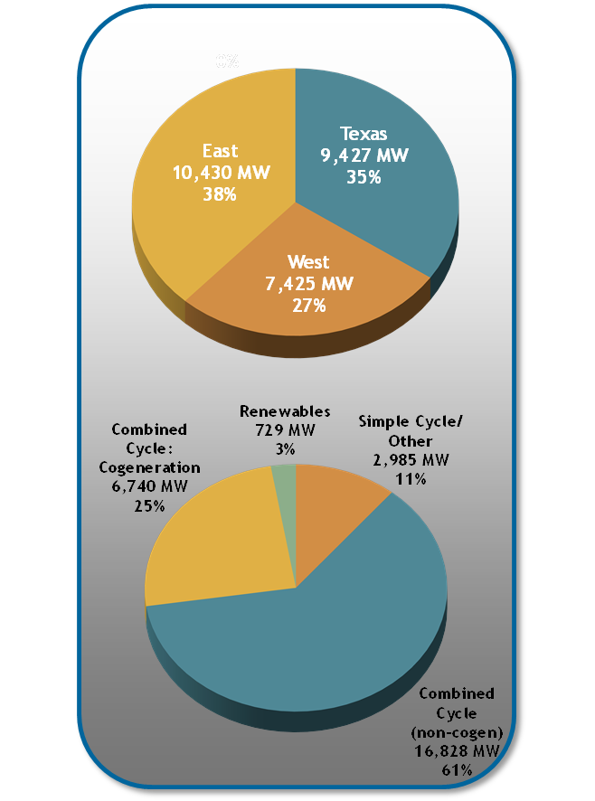
Calpine: National Portfolio of Nearly 27,000 MW
Geographic Diversity
As of 6/30/2016
Geographically diversified portfolio: Scale in three most competitive power markets in America
Largest operator of combined heat and power (cogeneration) technology in America
Largest geothermal power producer in America
Featuring one of smallest environmental footprints in America’s power generation sector
2

Slide 4
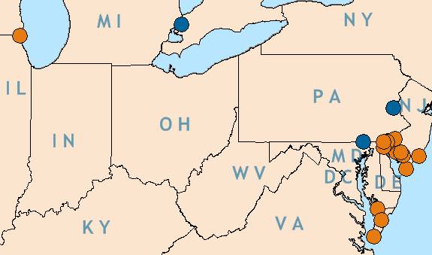
Calpine PJM Asset Profile
Current Generating Assets
Efficient, flexible combined-cycle | 3,134 MW
Quick-ramping (peaking) simple-cycle | 1,977 MW
Renewable solar | 4 MW
Total | 5,111 MW
Combined Cycle
Simple Cycle
Solar
Garrison Energy Center
York 2 Energy Center
Garrison Energy Center
209 MW Natural Gas-fired Combined-cycle
Located in Dover, DE
Phase 2: TBD
Newest PJM Project (in-service June 2015)
York 2 Energy Center
830 MW Natural gas-fired combined-cycle
Located in Peach Bottom Township, PA
Target COD: 2017
3

Slide 5
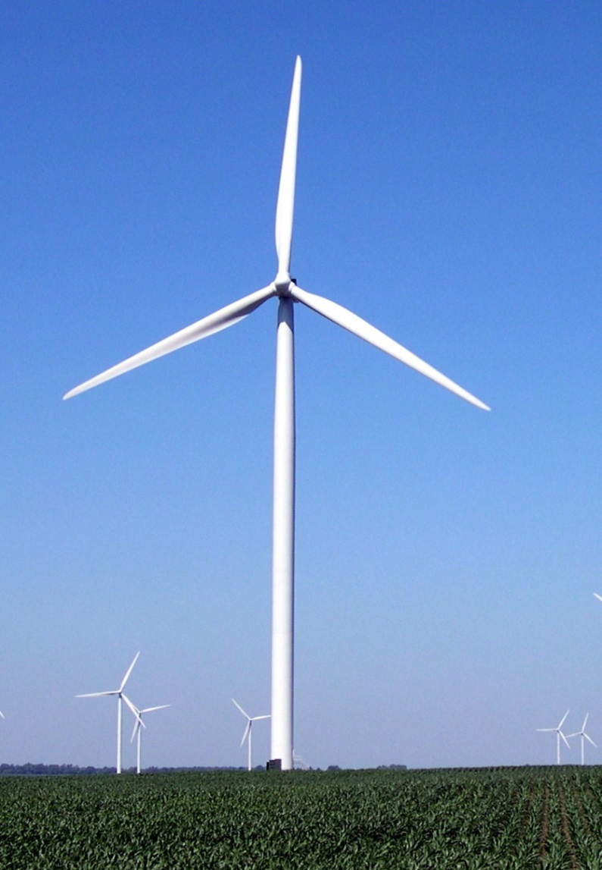
Calpine: Wind Expansion
In early 2015, Calpine launched a renewable energy group with vision of becoming long-term owner and operator of commercial scale wind projects.
Calpine is newly committed to developing more than 1 GW of wind energy projects.
Calpine’s renewable energy development team has over 40 years combined experience and has developed over 2.5GW of greenfield wind energy projects that are currently operating under long-term contracts with numerous utility off-takers across the United States and Canada, including over 1.5GW in the Midwest.
4

Slide 6
Calpine: Clean Fleet
5

Slide 7
Calpine Has Been A Very Strong Supporter of Environmental Regulation
Calpine has been an early and consistent supporter or state and federal initiatives to reduce pollutants and GHG emissions from power plants.
Lone energy producer to file Amicus Brief in support of EPA’s right to regulate greenhouse gas emissions from power plants in Murray Energy
Calpine’s Russell City Energy Center was the nation’s first power plant to voluntarily receive an air permit that included a limit on GHG emissions
Supporter of the Northeast Regional Greenhouse Gas Initiative (RGGI)
Supported AB 32 and SB 350 in California
Supported Governor’s Executive Order to require the state to reduce GHG emissions 40% below 1990 levels by 2030
Calpine was one of two power companies invited to The White House when the final Clean Power Plan was unveiled in August 2015. Pictured (L-R): President Barack Obama (D) and Calpine CEO Thad Hill.
6

Slide 8
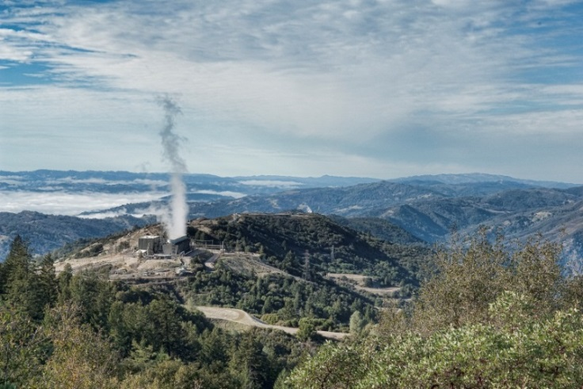
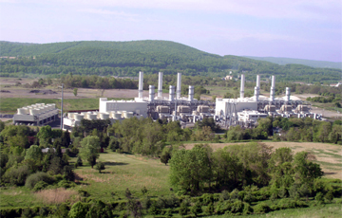
Clean Power Plan
Calpine supports climate change regulation and programs that rely upon market forces to drive GHG reductions.
Calpine has been very active in supporting EPA and the CPP
Filed an amicus brief in support of EPA in litigation in 2015
Only power generator to support EPA in early litigation (in re: Murray Energy Corp., No. 14-1112 (D.C. Cir. 2015)
Calpine is part of a coalition of ten power companies (representing 10% of U.S. generation capacity) defending the Clean Power Plan
Will support EPA in support of the CPP at Supreme Court
The Geysers - California
Bethlehem Energy Center - Pennsylvania
7

Slide 9
Different Technologies Have Different Characteristics
Resource Type | CO2 | Water Impact | Capacity Value | Operating characteristics | Other
CCGT | Low | Moderate | High | Flexible | NOX
Coal | High | High | High | Less Flexible | SO2 / NOX / Mercury
Nuclear | None | High | High | Not Flexible | Nuclear Waste
Wind | None | None | Low | Intermittent / Seasonal | Birds / Bats / Land use
Utility Scale Solar | None | None | Low | Intermittent / Seasonal | Habitat / Land use
Hydro | None | High | Low / Moderate | Intermittent / Seasonal | Fish / aquatic impacts
8

Slide 10
PJM Markets are Working Well
PJM average power prices hit 15-year low in March 2016
2019/2020 Auction Results
PJM's load-weighted average LMP was $22.97/MWh in March
First quarter, average LMPs have been less than $30/MWh, and in no calendar year has PJM had sub-$30/MWh average LMPs since PJM started LMPs in April 1999
First quarter of 2016's prices have similarly been the lowest for any Q1 since 2002
The clearing price was $100/megawatt-day for the majority of the region
The auction attracted 5,074 MW of new gas-fired generation
Eastern MAAC: $119.77/MW-day; BGE $100.30/MW-day; ComEd $202.77/MW-day
Source: PJM
9

Slide 11
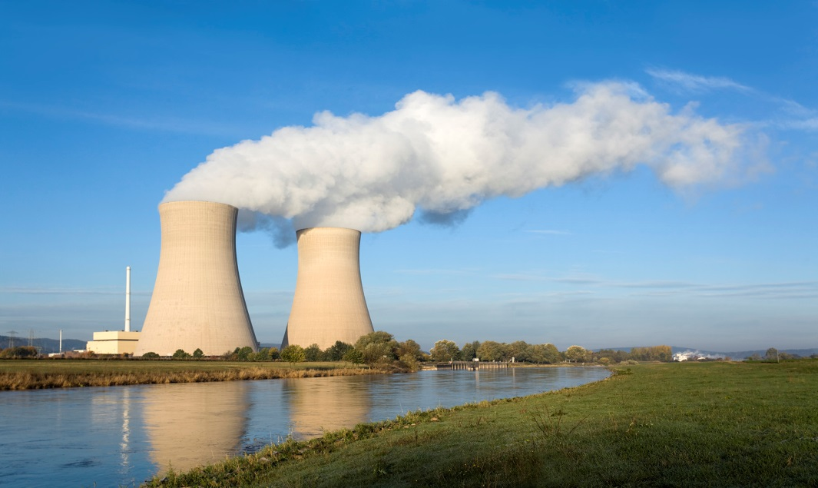
Is There a Problem for Nuclear?
Of the 38 Nuclear Units in PJM
1 on planned retirement path for several years (Oyster Creek)
2 announced recent retirement plans (Quad Cities)
2 indicate financial problems (TMI, Davis Bessie)
Christine Todd-Whitman, WSJ (November 2015)
“Poorly structured electricity markets are putting at risk other well-operated, proven nuclear-energy facilities in New York, Ohio, Illinois, and other states. Once closed, these plants won’t reopen. We must act now before it is too late.”
Former Sen. Judd Gregg for Nuclear Matters (September 2016)
“It is essential that policymakers take steps to value the carbon-free attributes of nuclear energy so that we can continue to enjoy the benefits these plants provide so that we can successfully achieve our clean energy future.”
10

Slide 12
Nuclear Subsidy Efforts in PJM and Surrounding States
State activities throughout PJM
Surrounding States
Ohio: attempted PPA for Davis Bessie
New York: ZEC program for 4 upstate Nuclear Units
Illinois: Legislative proposal to mandate ZEC like program
New Jersey: Early stage proposal to create RPS tier for Nuclear
Pennsylvania: Rumblings on the future of TMI
Connecticut: Legislative proposal for Millstone
11

Slide 13
We Support Programs and Regulations that Rely on Market Forces
1. Non-discriminatory market solutions that incorporate carbon pricing into the energy market. Reflecting the carbon mitigation of value of both low carbon and zero carbon resources:
RGGI like Scheme
RTO administered Carbon adder
2. Where States take actions that result in discriminatory schemes that only benefit certain resources, or certain classes of resources:
It is incumbent on the RTO to take the necessary steps to defend and protect its markets
MOPR
APR
PJM MOPR alternative
12

